Slide 1

Database Systems
TIF 2302

Slide 2

Why Databases?

Slide 3
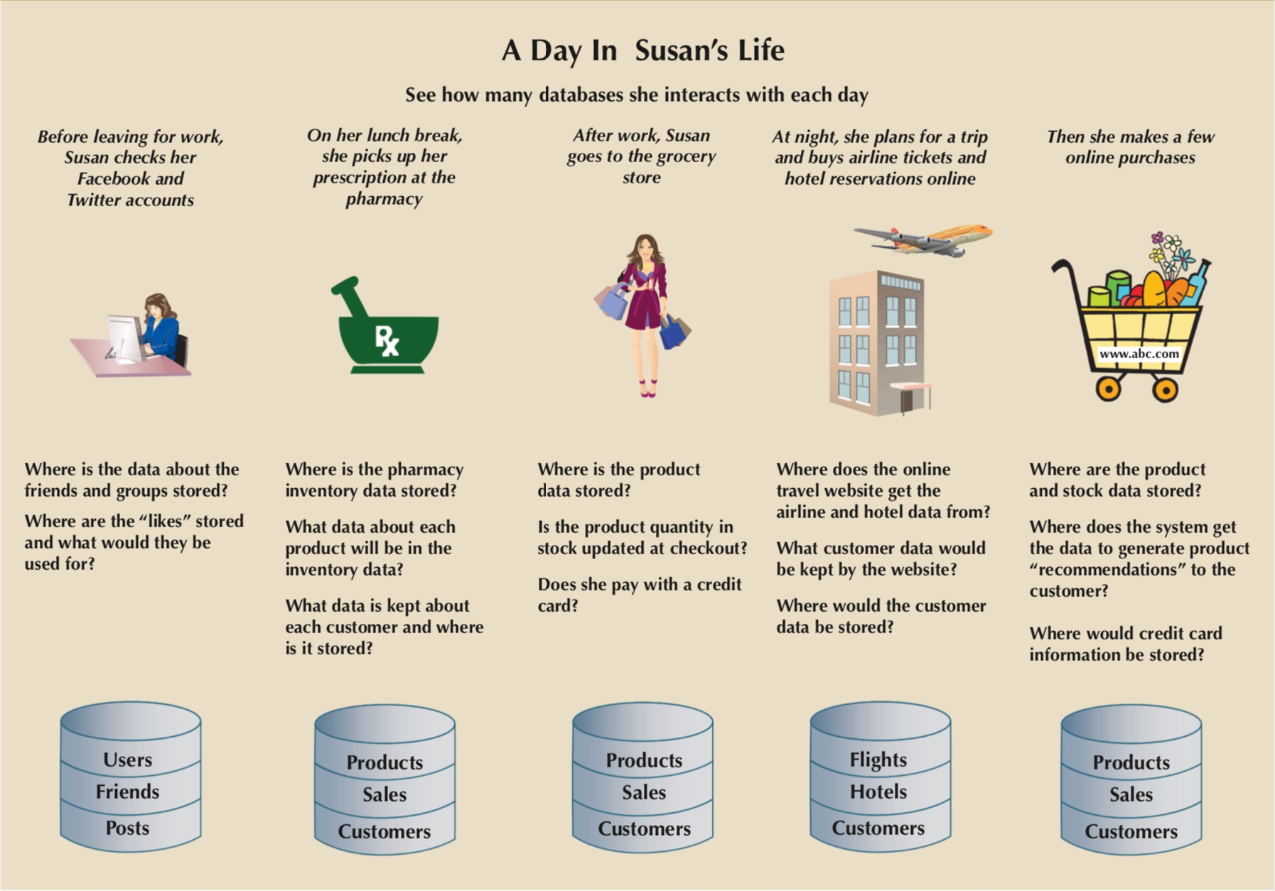
Figure 1- The Pervasive Nature Of Databases

Slide 4
Why Study Databases?
Many computing applications deal with large amounts of information.
Database systems give a set of tools for storing, searching and managing this information.
Databases are a ‘core topic’ in computer science and IT.
Basic concepts and skills with database systems are part of the skill set you will be assumed to have as a CS and IT graduate.

Slide 5
Data vs. Information
Data
Raw facts
Raw data - Not yet been Processed to reveal the meaning
Building blocks of information
Data Management
Generation, Storage, and retrieval of data
Information
Produced by processing data
Reveals the meaning of data
Enables knowledge creation
Should be accurate, relevant, and timely to enable good decision making

Slide 6
Traditional File-Based Systems
File-based Approach
A Collection Of Application Programs That Perform Services For The System End-users Such As The Production Of Reports.
Each Program Defines And Manages Its Own Data.

Slide 7

An Example
Exports apples
Price is 100G per container of apples
Departments:
Merchandise
Overseas Business
Export

Slide 8
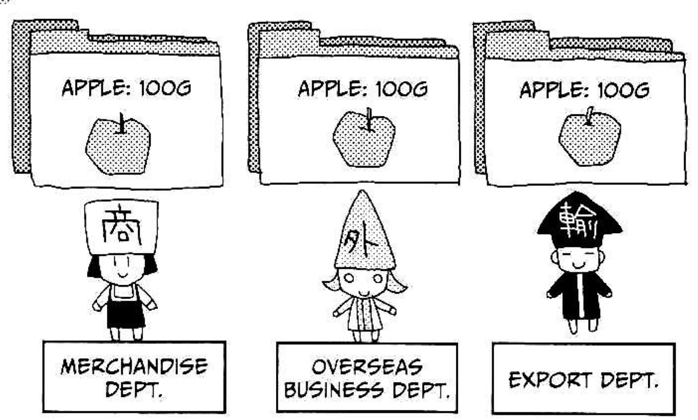
An Example
Multiple copies of some data
Problems
Data is duplicated in each department
Each department has separate data

Slide 9
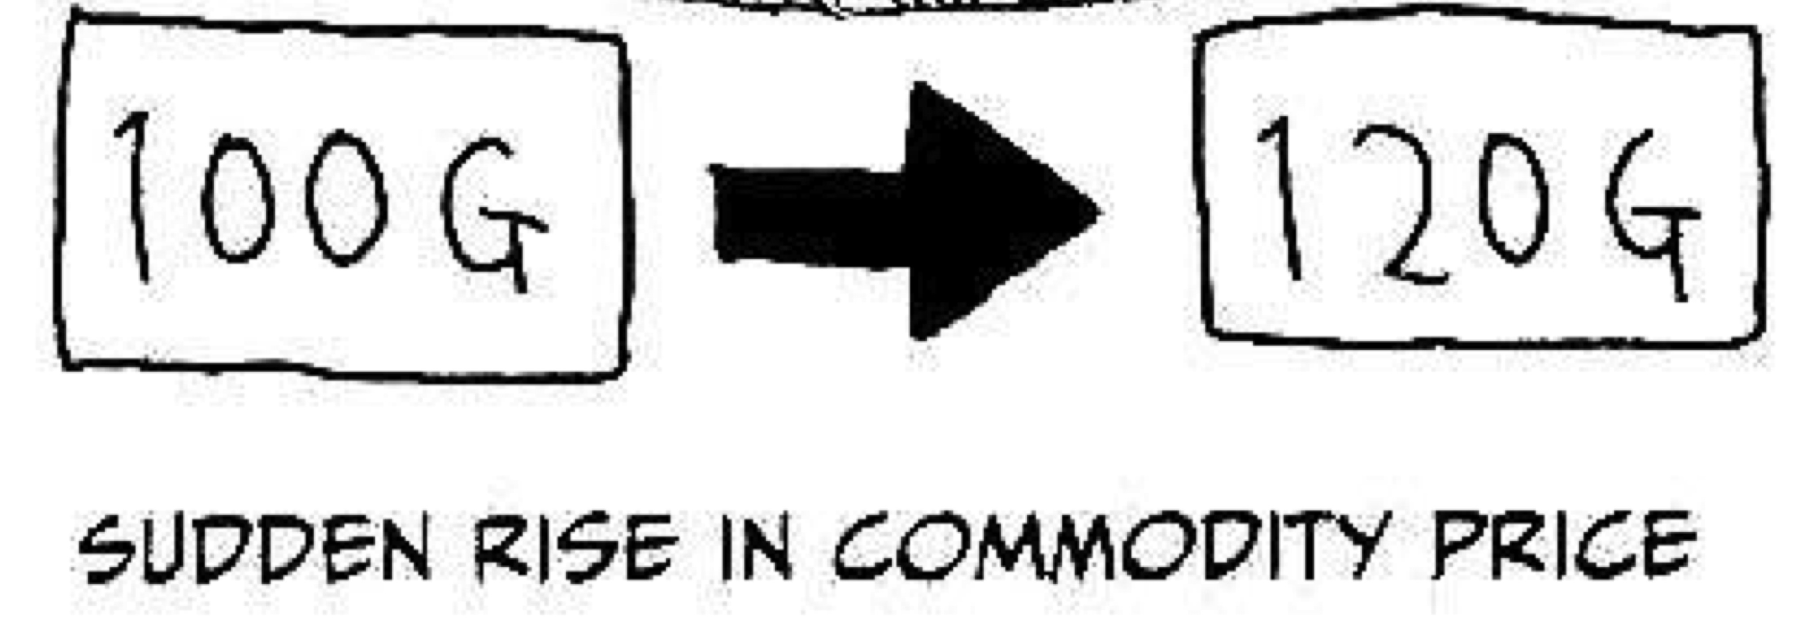
An Example
Can create another problems
When the price of apple went up

Slide 10
An Example

Slide 11
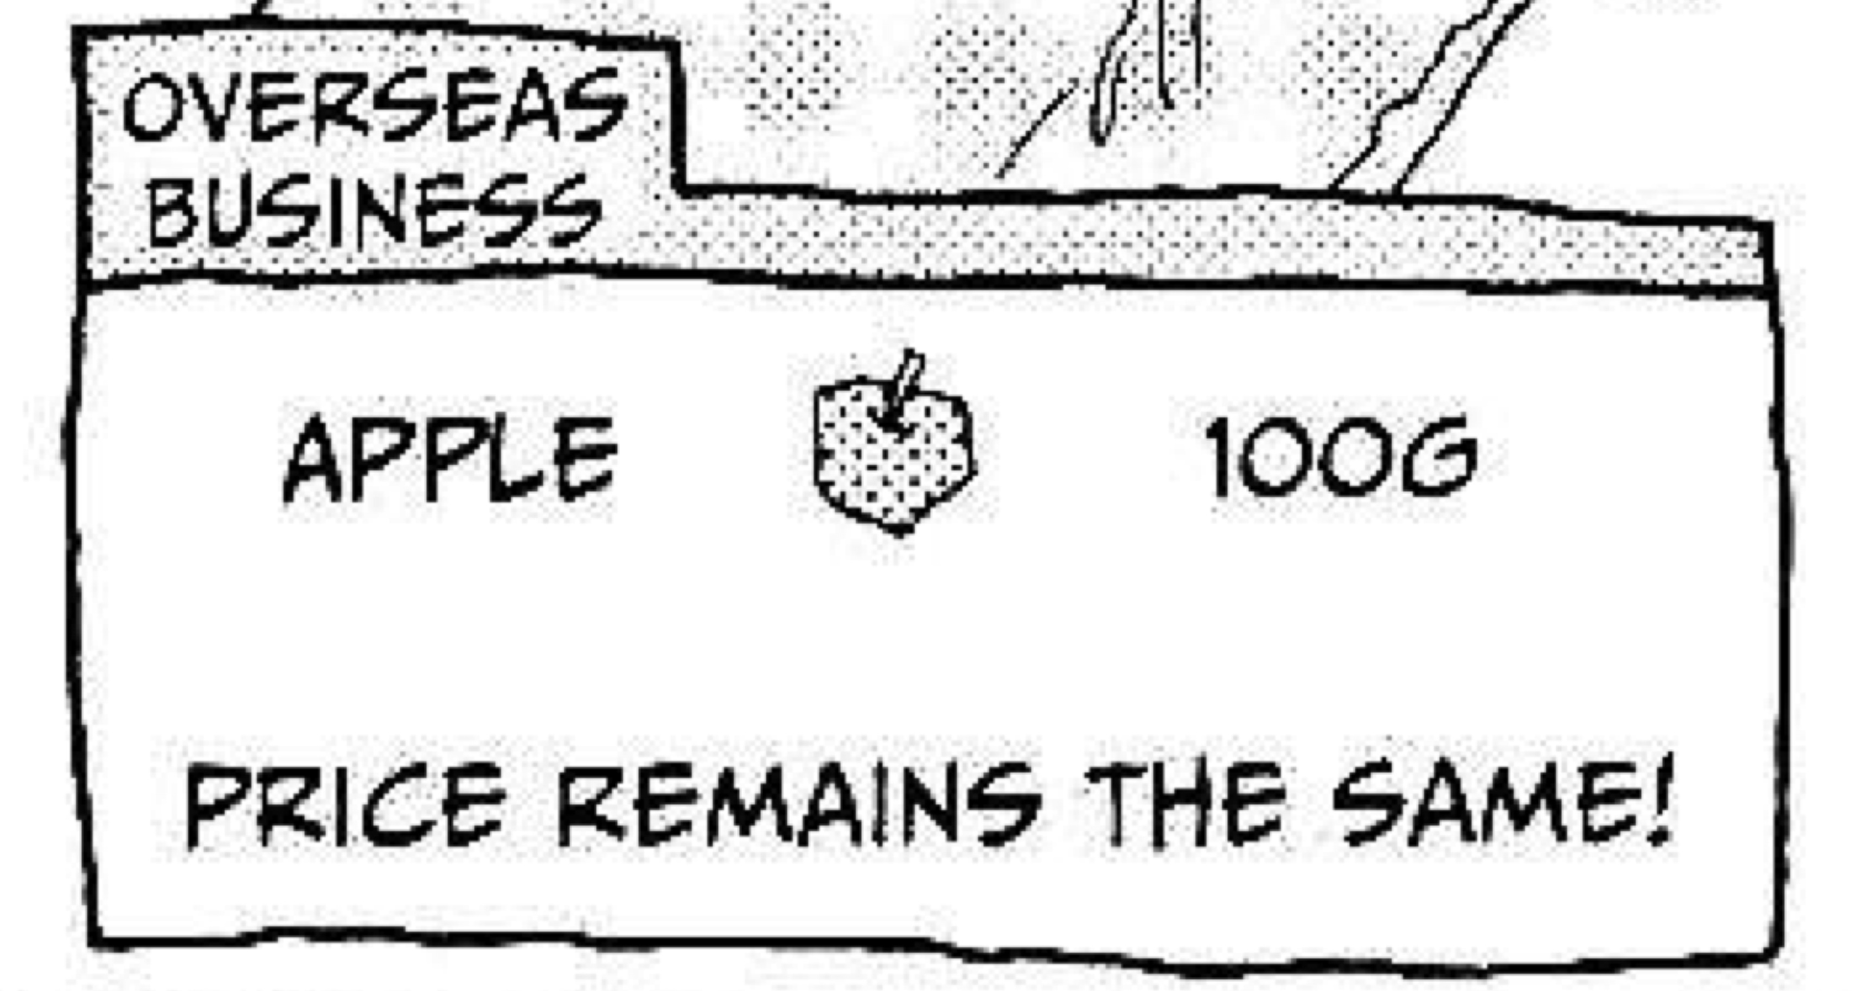
An Example
Mistakes get made; the overseas business department didn’t get the message...

Slide 12
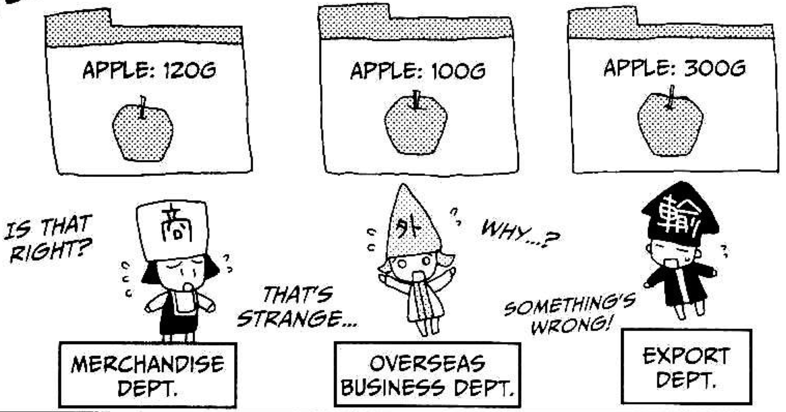
An Example
Another department changed

Slide 13
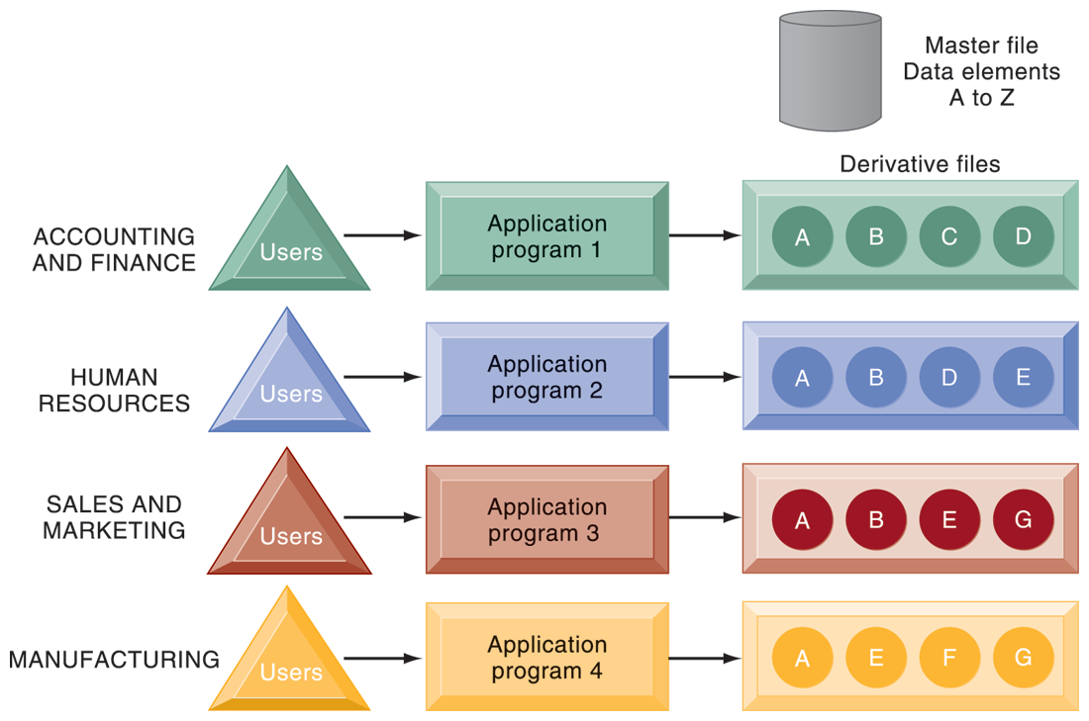
Traditional File Processing

Slide 14
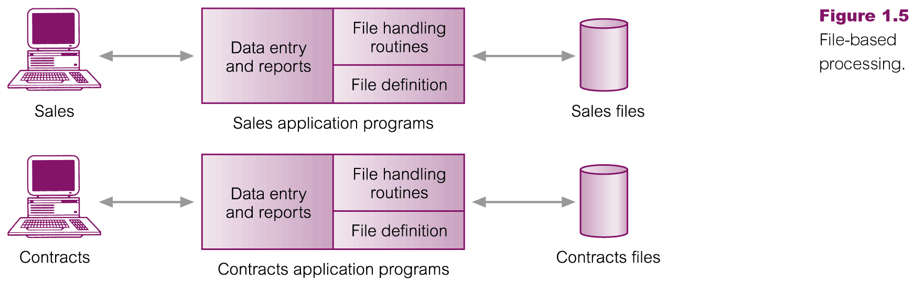
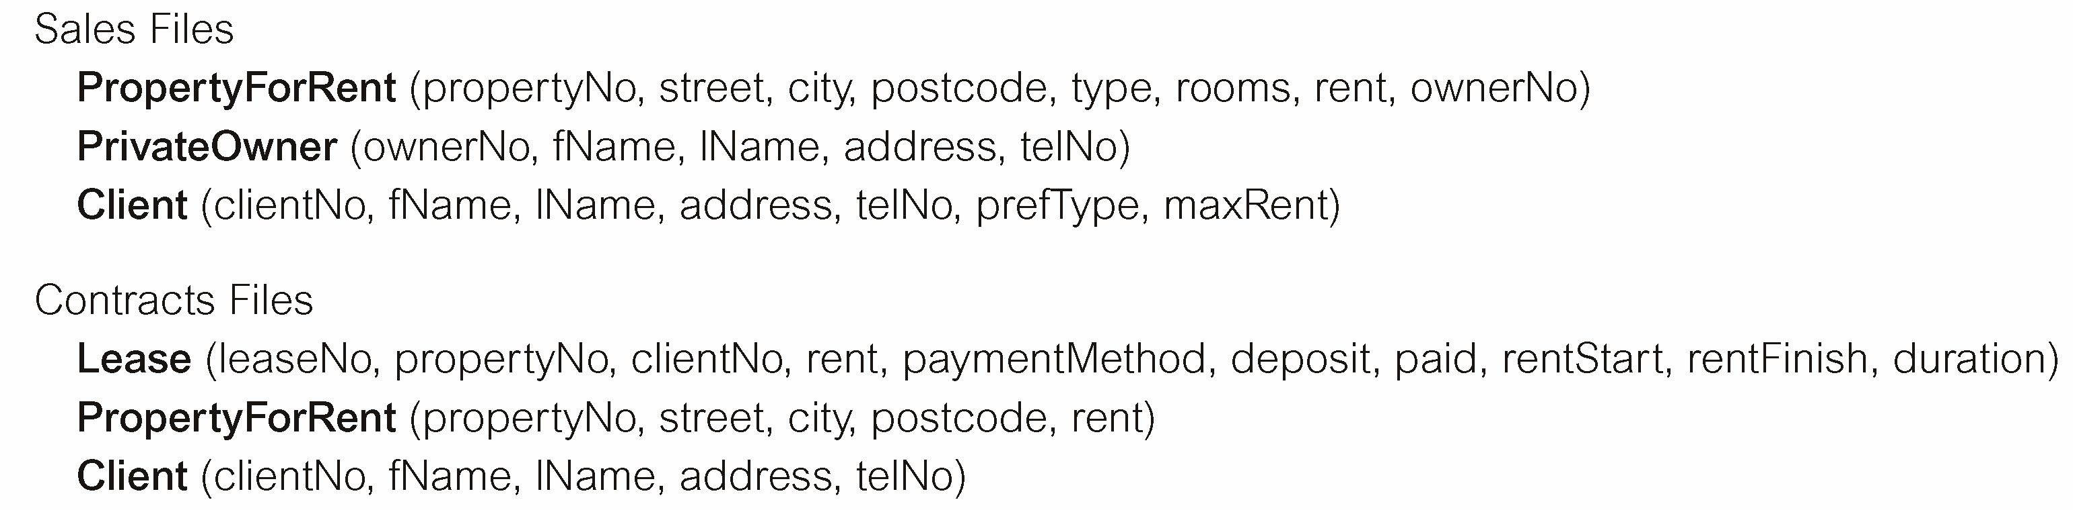
Traditional File Processing

Slide 15
Limitations of the File-Based Approach
Separation and isolation of data
Duplication of data
Data dependence
Incompatible file formats
Fixed queries/proliferation of application programs

Slide 16

Structural and Data Dependence
Structural dependence: Access to a file is dependent on its own structure
All file system programs are modified to conform to a new file structure
Structural independence: File structure is changed without affecting the application’s ability to access the data

Slide 17
Structural and Data Dependence
Data dependence
Data access changes when data storage characteristics change
Data independence
Data storage characteristics is changed without affecting the program’s ability to access the data
Practical significance of data dependence is difference between logical and physical format

Slide 18

Data Redundancy
Unnecessarily storing same data at different places
Islands of information: Scattered data locations
Increases the probability of having different versions of the same data

Slide 19
Data Redundancy Implications
Poor data security
Data inconsistency
Increased likelihood of data-entry errors when complex entries are made in different files
Data anomaly: Develops when not all of the required changes in the redundant data are made successfully

Slide 20
Types of Data Anomaly
Update Anomalies
Insertion Anomalies
Deletion Anomalies

Slide 21
Lack of Design and Data-Modeling Skills
Evident despite the availability of multiple personal productivity tools being available
Data-modeling skills is vital in the data design process
Good data modeling facilitates communication between the designer, user, and the developer

Slide 22
Database approach

Slide 23
Database
database to be a collection of related data
database management system (DBMS) to be the software that manages and controls access to the database.
A database application is simply a program that interacts with the database at some point in its execution.
database system as a collection of application programs that interact with the database along with the DBMS and the database itself.

Slide 24
Database
A shared collection of logically related data and its description designed to meet the information needs of an organization.

Slide 25
Database management system (DBMS)
Collection of programs
Manages the database structure
Controls access to data stored in the database

Slide 26
Role of the DBMS
Intermediary between the user and the database
Enables data to be shared
Presents the end user with an integrated view of the data
Receives and translates application requests into operations required to fulfill the requests
Hides database’s internal complexity from the application programs and users

Slide 27
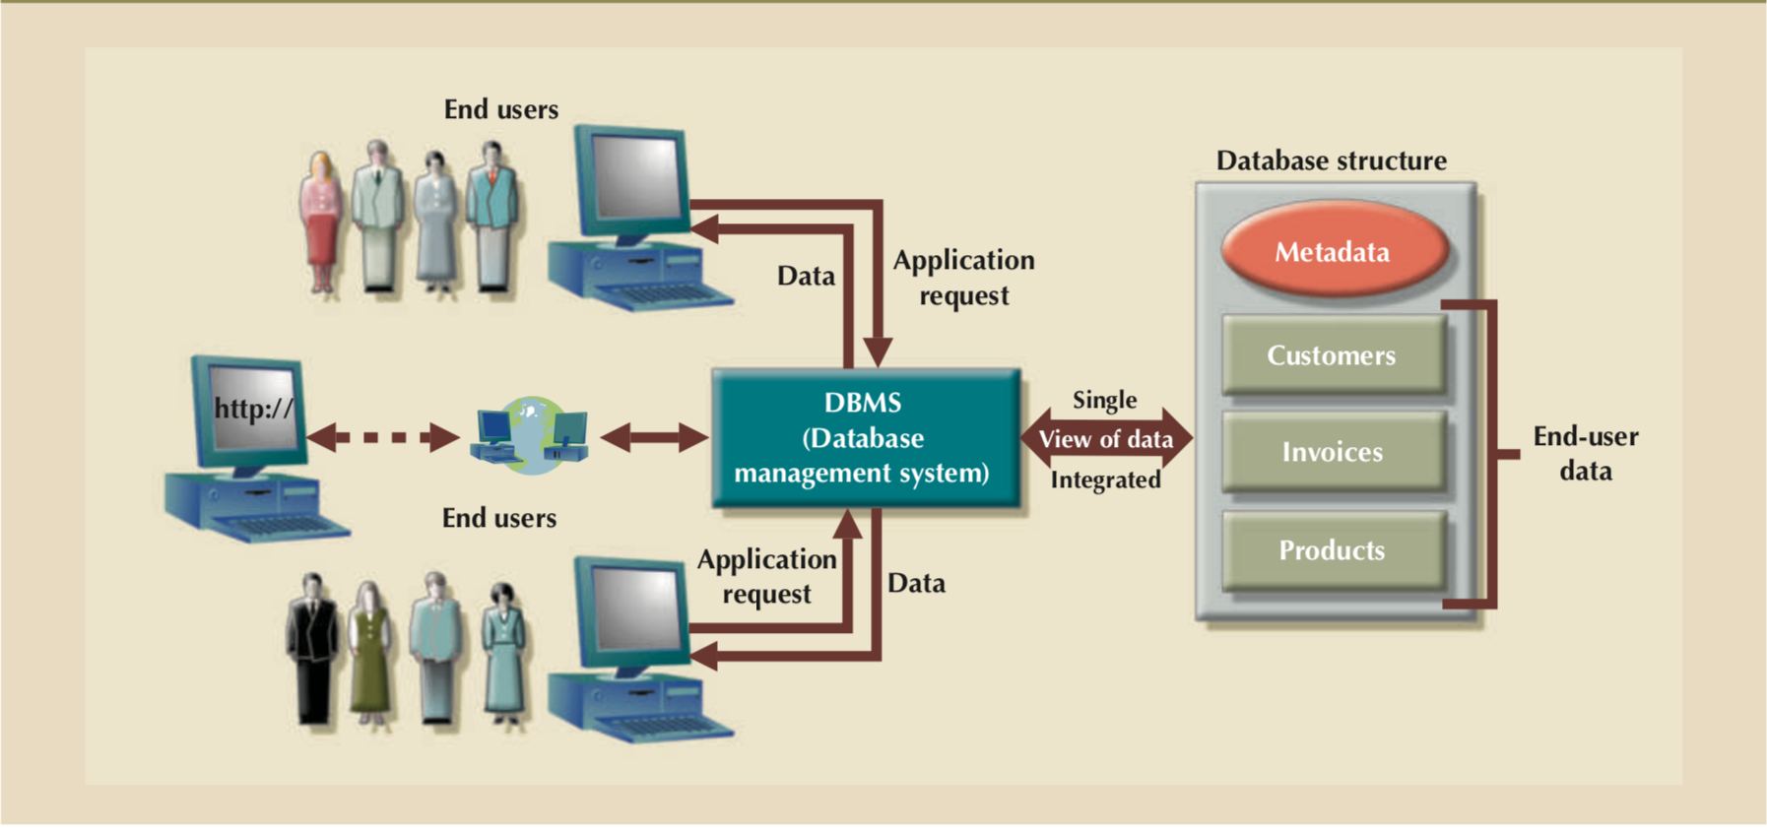
Figure 2 - The DBMS Manages the Interaction between the End User and the Database

Slide 28
Advantages of the DBMS
Better data integration and less data inconsistency
Data inconsistency: Different versions of the same data appear in different places
Increased end-user productivity, Improved:
Data sharing
Data security
Data access
Decision making
Data quality: Promoting accuracy, validity, and timeliness of data

Slide 29
Types of Databases
Single-user database: Supports one user at a time
Desktop database: Runs on PC
Multiuser database: Supports multiple users at the same time
Workgroup databases: Supports a small number of users or a specific department
Enterprise database: Supports many users across many departments

Slide 30
Types of Databases
Centralized database: Data is located at a single site
Distributed database: Data is distributed across different sites
Cloud database: Created and maintained using cloud data services that provide defined performance measures for the database

Slide 31
Types of Databases
General-purpose databases: Contains a wide variety of data used in multiple disciplines
Discipline-specific databases: Contains data focused on specific subject areas

Slide 32

Types of Databases
Online analytical processing (OLAP)
Enable retrieving, processing, and modeling data from the data warehouse
Business intelligence: Captures and processes business data to generate information that support decision making

Slide 33
Types of Databases
Unstructured data: It exists in their original state
Structured data: It results from formatting
Structure is applied based on type of processing to be performed
Semistructured data: Processed to some extent
Extensible Markup Language (XML)
Represents data elements in textual format

Slide 34
Database Design
Focuses on the design of the database structure that will be used to store and manage end-user data
Well-designed database
Facilitates data management
Generates accurate and valuable information
Poorly designed database causes difficult-to-trace errors

Slide 35
Database Systems
Logically related data stored in a single logical data repository
Physically distributed among multiple storage facilities
DBMS eliminates most of file system’s problems
Current generation DBMS software:
Stores data structures, relationships between structures, and access paths
Defines, stores, and manages all access paths and components

Slide 36
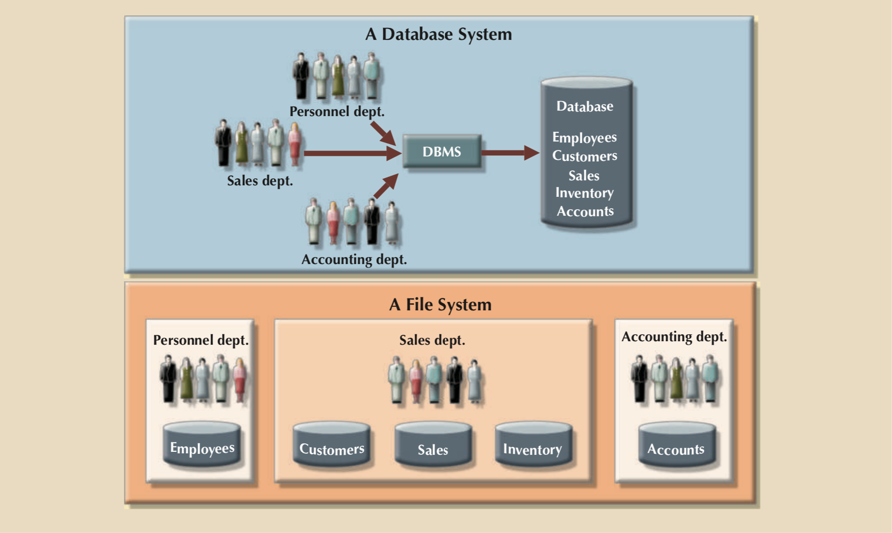
Figure 3 - Contrasting Database and File Systems

Slide 37
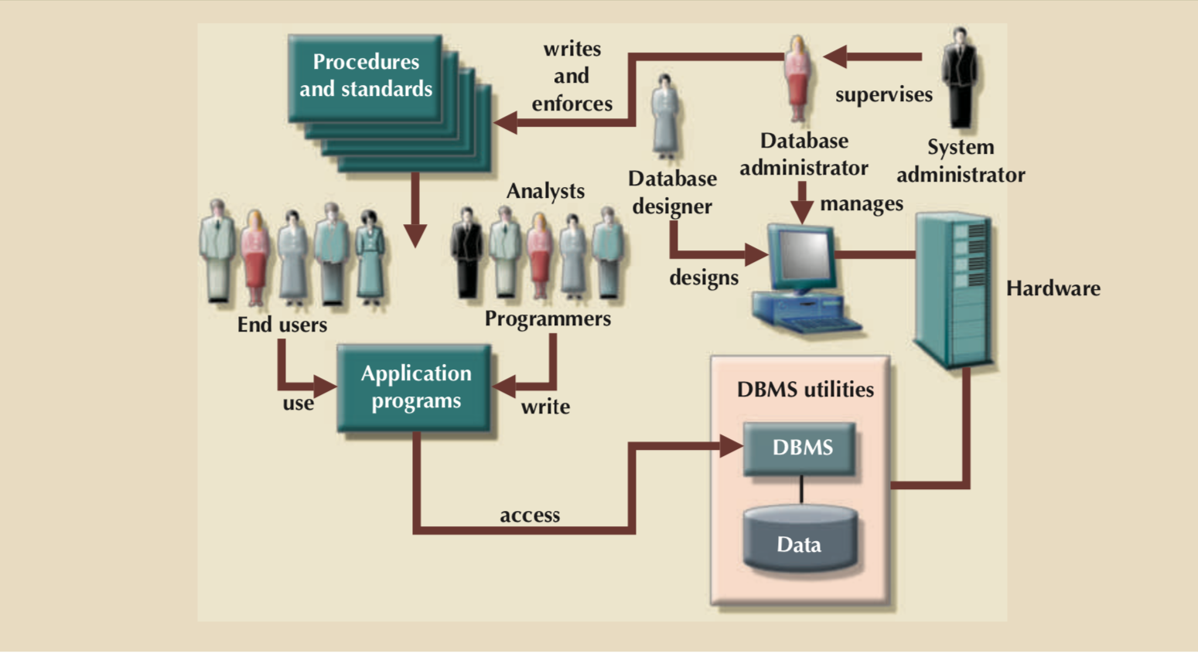
Figure 4 - The Database System Environment

Slide 38
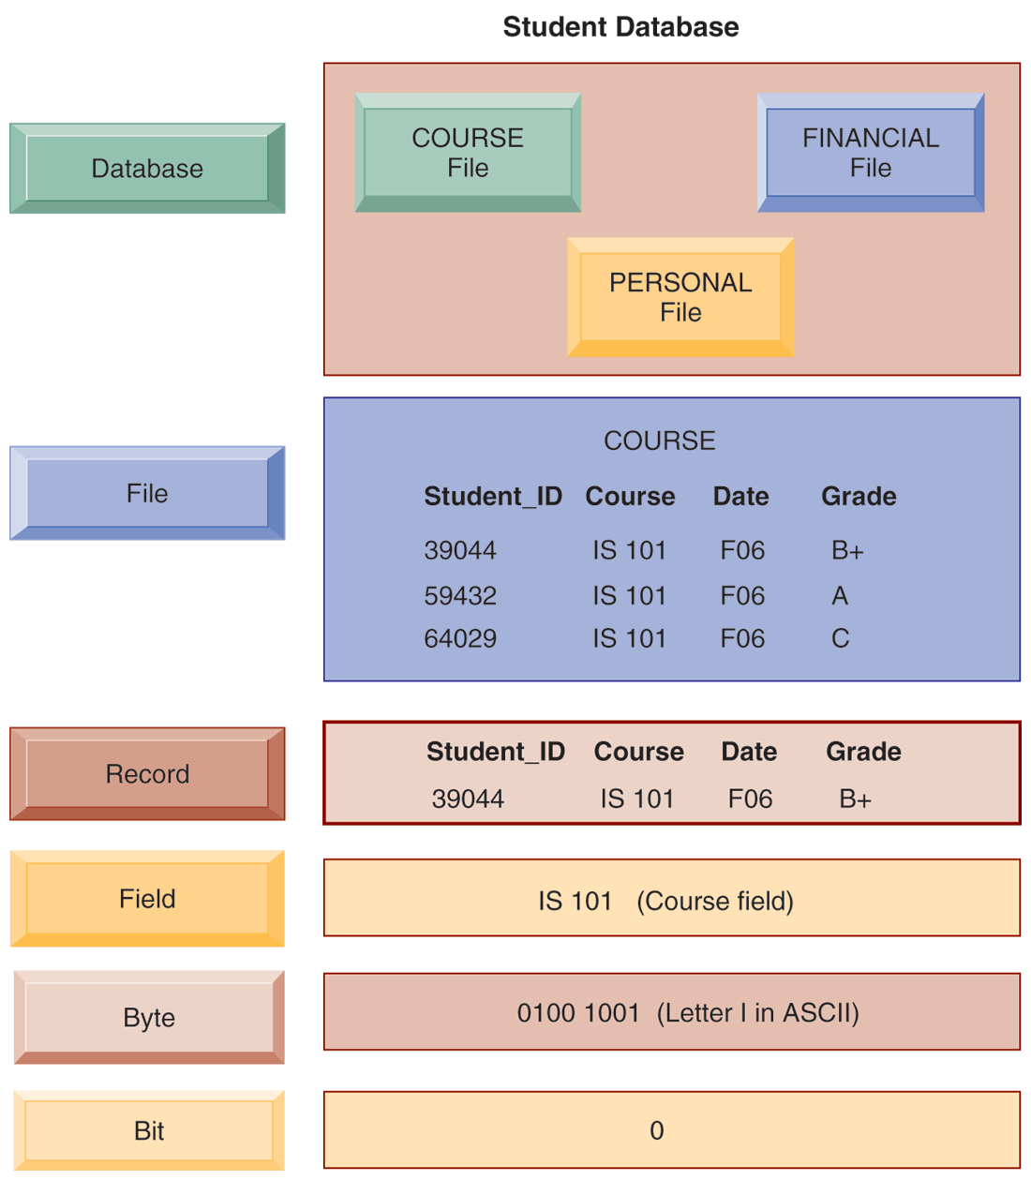

Slide 39
DBMS Functions
Data dictionary management
Data dictionary: Stores definitions of the data elements and their relationships
Data storage management
Performance tuning: Ensures efficient performance of the database in terms of storage and access speed
Data transformation and presentation
Transforms entered data to conform to required data structures

Slide 40
DBMS Functions
Security management
Enforces user security and data privacy
Multiuser access control
Sophisticated algorithms ensure that multiple users can access the database concurrently without compromising its integrity
Backup and recovery management
Enables recovery of the database after a failure
Data integrity management
Minimizes redundancy and maximizes consistency

Slide 41
DBMS Functions
Database access languages and application programming interfaces
Query language:Lets the user specify what must be done without having to specify how
Structured Query Language(SQL):Defacto query language and data access standard supported by the majority of DBMS vendors

Slide 42
DBMS Functions
Database communication interfaces
Accept end-user requests via multiple, different network environments

Slide 43
Disadvantages of Database Systems
Increased costs
Management complexity
Maintaining currency
Vendor dependence
Frequent upgrade/replacement cycles

Slide 44
